Slide 1
Recurrent Neural Networks

Slide 2
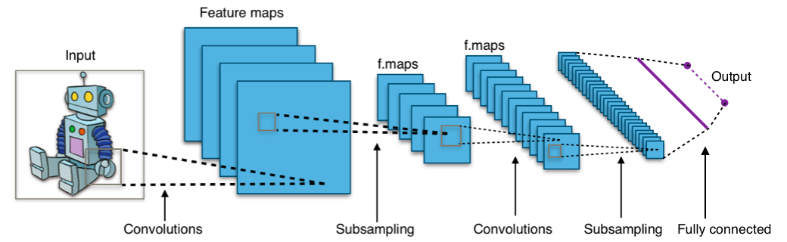
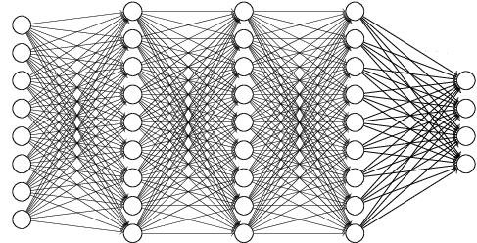
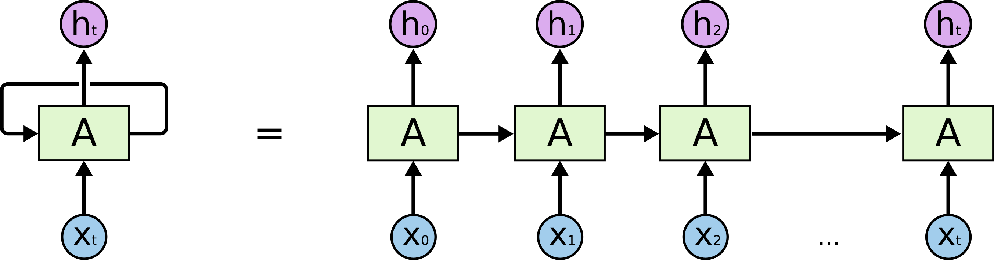
Practice 1
Next word prediction (Language Model)
Predict the next word using previous k words
Ex) It is too late I want to go ???
<Convolutional Neural Network>
<Dense Network>
<Recurrent Neural Network>

Slide 3
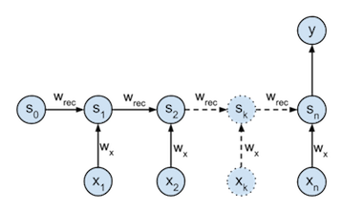
Practice 1: RNN
Setup Layers (Model)
Input Layer=Embedding Layer(128, 7)
Output Layer (10000)
???
Output Layer
Hidden Layer
Input Layer
It
is
to
go

Slide 4
Practice 1: RNN
Data Set
Penn Tree Bank (PTB) dataset
Widely used in machine learning of NLP
Relatively small size of data
Widely use to evaluate performance of model
Total number : 49,000 sentences (5MB)
Vocabulary : 10,000
Example)
longer maturities are thought to indicate declining interest rates because they permit portfolio managers to retain relatively higher rates for a longer period
shorter maturities are considered a sign of rising rates because portfolio managers can capture higher rates sooner

Slide 5
Practice 1: DNN
Step
Preprocessing
Build Model
Train Model

Slide 6
Practice 1: RNN
Code (Preprocessing)
data_loader.py (1)
import numpy as np class text_data(object): def __init__(self, path="../../dataset", max_len=40): self.train_pt, self.val_pt, self.test_pt = 0, 0, 0 self.path = path self.max_len = max_len self.w2idx ={"<>": 0} self.train_ids, self.train_len = self.file_to_ids(path+"/ptb.train.txt") self.val_ids, self.val_len = self.file_to_ids(path + "/ptb.valid.txt") self.test_ids, self.test_len = self.file_to_ids(path + "/ptb.test.txt") self.vocab_size = len(self.w2idx) self.train_size = len(self.train_ids) self.val_size = len(self.val_ids) self.test_size = len(self.test_ids) self.idx2w = {} for word in self.w2idx: self.idx2w[self.w2idx[word]] = word

Slide 7
Practice 1: RNN
Code (Preprocessing)
data_loader.py (2)
def file_to_ids(self, file_name): with open(file_name, "r") as fin: lines = fin.readlines() length, ids = [], [] for num, line in enumerate(lines): id = [] words = line.split() for i, word in enumerate(words): if i == self.max_len: break if word not in self.w2idx: self.w2idx[word] = len(self.w2idx) id.append(self.w2idx[word]) ids.append(id) length.append(i) if num == 10000: # 데이터 크기는 원하는 사이즈 만큼 자르기 break return np.array(ids), np.array(length)

Slide 8
Practice 1: RNN
Code (Preprocessing)
data_loader.py (3)
def get_train(self, batch_size=20): # batch size 결정 pt = self.train_pt self.train_pt = (self.train_pt + batch_size) % self.train_size return self.train_ids[pt: pt+batch_size], self.train_len[pt: pt+batch_size] def get_val(self, batch_size=20): pt = self.val_pt self.val_pt = (self.val_pt + batch_size) % self.val_size return self.val_ids[pt: pt+batch_size], self.val_len[pt: pt+batch_size] def get_test(self, batch_size=20): pt = self.test_pt self.test_pt = (self.test_pt + batch_size) % self.test_size return self.test_ids[pt: pt+batch_size], self.test_len[pt: pt+batch_size]

Slide 9
Practice 1: RNN
Model
Add Embedding Layer
Setup Layers (RNN)
Make Loss and Optimization
Train Model

Slide 10
Practice 1: RNN
Embedding Layer (Model)
Code
Setup Layers (Model)
Code
# Embedding self.emb_W = self.get_var(name='emb_W', shape=[self.vocab_size, self.emb_dim]) self.x_emb = tf.nn.embedding_lookup(self.emb_W, self.x)
def build_model(self): lstm_cell = rnn.BasicLSTMCell(self.hidden_dim) output, states = tf.nn.dynamic_rnn(cell=lstm_cell, inputs=self.x_emb, dtype=tf.float32) # output 의 맨 마지막 hidden state만 사용 last_output = output[:, self.num_k-1, :] out_W = self.get_var(name="out_W", shape=[self.hidden_dim, self.vocab_size]) out_b = self.get_var(name="out_b", shape=[self.vocab_size]) self.word_prob = tf.nn.softmax(tf.matmul(last_output, out_W) + out_b) self.out_y = tf.argmax(self.word_prob, 1)

Slide 11
Practice 1: RNN
Result
it: 550 | loss: 5.605 - 167.52s
it: 600 | loss: 5.616 - 175.65s
it: 650 | loss: 5.578 - 183.75s
it: 700 | loss: 5.395 - 191.74s
it: 750 | loss: 5.485 - 200.09s
test loss: 5.718
32 the

Slide 12
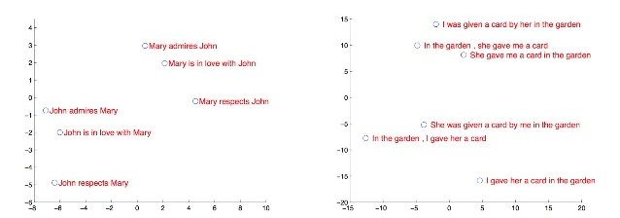
Practice 2: Sentence Analysis
Sentence Analysis
Sentences are embedded into sen2vec space
The distance between the two similar sentences is close!

Slide 13
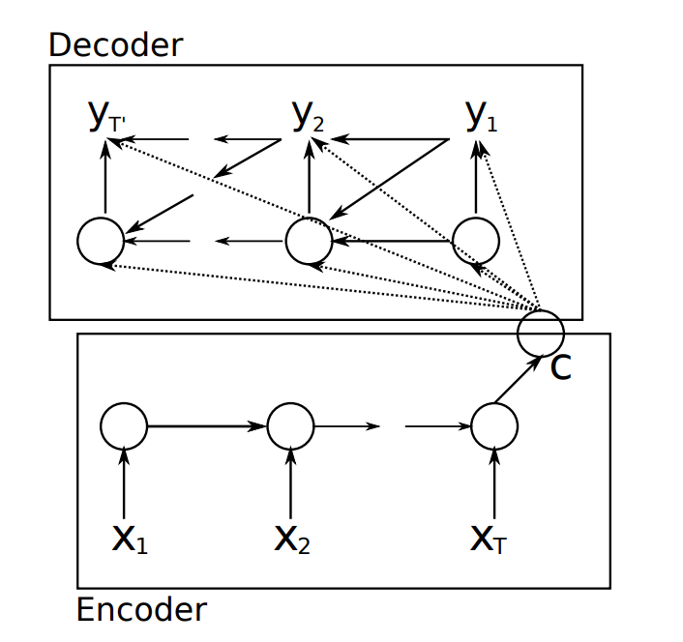
Practice 2: Sentence Analysis
Sentence Embedding
Encoder
Encoding entire sequence into a fixed length vector called a context vector
Decoder
Decoding sequence reading from the context vector
Input x = Output y
Context vector ➔ Sentence Embedding

Slide 14
Practice 2: Sentence Analysis
Preprocessing
Difference from Practice 1
Input length in Practice 1 is fixed
Input length in Practice 2 is variable
Add symbol <eos> to the end of the sentences
def file_to_ids(self, file_name): with open(file_name, "r") as fin: lines = fin.readlines() length, ids = [], [] for num, line in enumerate(lines): id = np.zeros(self.max_len, dtype=np.int32) line += " <eos>" words = line.split() for i, word in enumerate(words): if i == self.max_len: break if word not in self.w2idx: self.w2idx[word] = len(self.w2idx) id[i] = self.w2idx[word] ids.append(id) length.append(i) if num == 100000: break return np.array(ids), np.array(length)

Slide 15
Practice 2: Sentence Analysis
Model
Add Embedding Layer
Setup Layers (RNN Encoder-Decoder)
Make Loss and Optimization
Train Model

Slide 16
Practice 2: Sentence Analysis
Make Placeholder
Code
Remove <eos>
Fix max length in batch-size data
# Placeholder self.x = tf.placeholder(dtype=tf.int32, shape=(None, max_len)) self.x_len = tf.placeholder(dtype=tf.int32, shape=(None, )) self.x_len = self.x_len – 1 self.batch_max_len = tf.reduce_max(self.x_len)

Slide 17
Practice 2: Sentence Analysis
Make Sequence Mask for different size
Code
# sequence mask for different size self.batch_size = tf.shape(self.x)[0] self.encoder_input = self.x[:,:] self.decoder_output = self.x[:,:] self.x_mask = tf.sequence_mask(lengths=self.x_len, maxlen=self.batch_max_len, dtype=tf.float32)
Input 1
[5 7 3 2 4 8 6]
Output 1
[5 7 3 2 4 8 6]
0 : <eos>
Mask 1
[1 1 1 1 1 1 1]
Output * Mask
Input 2
[3 2 4 8 X X X]
Output 2
[3 2 4 8 X X X]
0 : <eos>
Mask 2
[1 1 1 1 0 0 0]

Slide 18
Practice 2: Sentence Analysis
Embedding Layer (Model)
Code
# Embedding self.emb_W = self.get_var(name='emb_W', shape=[self.vocab_size, self.emb_dim]) self.input_emb = tf.nn.embedding_lookup(self.emb_W, self.encoder_input) self.output_emb = tf.nn.embedding_lookup(self.emb_W, self.decoder_output)

Slide 19
Practice 2: Sentence Analysis
Setup Layers (Model)
Code
Decoder cell can be likely same as Encoder cell
But, in next week, we apply attention mechanism
For each iteration in attention mechanism, calculate decoder hidden state using context vector
def build_model(self): # Encoder cell encoder_cell = tf.nn.rnn_cell.BasicLSTMCell(self.hidden_dim) # Dynamic encoding enc_output, self.enc_states = tf.nn.dynamic_rnn(cell=encoder_cell, inputs=self.input_emb, sequence_length=self.x_len, dtype=tf.float32) # Output layer self.out_layer = Dense(self.vocab_size, dtype=tf.float32, name='out_layer') # Decoder cell decoder_cell = tf.nn.rnn_cell.BasicLSTMCell(self.hidden_dim) helper = tf.contrib.seq2seq.TrainingHelper(self.output_emb, self.x_len, time_major=False) decoder = tf.contrib.seq2seq.BasicDecoder(decoder_cell, helper, self.enc_states, output_layer=self.out_layer) outputs, states, length = tf.contrib.seq2seq.dynamic_decode(decoder=decoder, maximum_iterations=self.max_len) self.logits = outputs.rnn_output self.output = tf.argmax(self.logits, 2)

Slide 20
Practice 2: Sentence Analysis
Build Loss
Code
Why multiply x_mask(cross_entory * x_mask)?
생성된 단어 개수가 기존 입력 문장보다 길 때, 입력 문장 길이 이후로 나오는 단어는 cross_entropy에 0으로 만듬으로써 학습에 영향을 주지 않도록 함
Why devide length(tf.reduce_sum(self.x_mask))?
학습 데이터의 길이가 각각 다르므로 길이만큼 나누어서 동일한 cross_entropy를 적용
def build_loss(self): target_labels = self.decoder_output[:, :self.batch_max_len] self.cross_entropy = tf.nn.sparse_softmax_cross_entropy_with_logits( labels=target_labels, logits=self.logits) self.loss = tf.reduce_sum(self.cross_entropy * self.x_mask) / (tf.reduce_sum(self.x_mask) + 1e-10)

Slide 21
Practice 2: Sentence Analysis
Train Model
Code
avg_loss, it_cnt = 0, 0 it_log, it_test, it_save, it_sample = 10, 100, 1000, 100 start_time = time.time() for it in range(0, 10000): train_ids, length = data.get_train(BATCH_SIZE) print() loss, _ = sess.run([model.loss, model.update], feed_dict={model.x: train_ids, model.x_len: length}) avg_loss += loss it_cnt += 1

Slide 22
Practice 2: Sentence Analysis
Test Model
Code
def test_model(): num_it = int(len(data.test_ids) / BATCH_SIZE) test_loss, test_cnt = 0, 0 for _ in range(num_it): test_ids, length = data.get_test(BATCH_SIZE) loss = sess.run(model.loss, feed_dict={model.x: test_ids, model.x_len: length}) test_loss += loss test_cnt += 1 print("test loss: {:.3f}".format(test_loss / test_cnt))

Slide 23
Practice 2: Sentence Analysis
Sample Model
Code
Mapping each index to word
def sample_test(test_input=""): # test_input = raw_input("test text: ") # input("test text: ") for python 2, 3 words = test_input.split() input_x = np.zeros((1, max_len), dtype=np.int32) for i, word in enumerate(words): if i == max_len: break input_x[0][i] = data.w2idx[word] input_x_len = [i] output = sess.run(model.output, feed_dict={model.x: input_x, model.x_len: input_x_len}) line = " ".join([data.idx2w[o] for o in output[0]]) print(line)

Slide 24
Practice 2: Sentence Analysis
Result
Code
if it % it_log == 0: print(" it: {:4d} | loss: {:.3f} - {:.2f}s".format(it, avg_loss / it_cnt, time.time() - start_time)) avg_loss, it_cnt = 0, 0 if it % it_test == 0 and it > 0: test_model() if it % it_save == 0 and it > 0: model.save(sess) if it % it_sample == 0 and it > 0: sample_test(" there is no asbestos in our products now ")
Sess.close()

Slide 25
Practice 2: Sentence Analysis
Result
it: 1410 | loss: 0.520 - 888.27s
it: 1420 | loss: 0.516 - 889.02s
it: 1430 | loss: 0.438 - 889.80s
it: 1440 | loss: 0.382 - 890.54s
it: 1450 | loss: 0.448 - 891.29s
it: 1460 | loss: 0.386 - 892.06s
it: 1470 | loss: 0.357 - 892.83s
it: 1480 | loss: 0.458 - 893.60s
it: 1490 | loss: 0.329 - 894.35s
it: 1500 | loss: 0.384 - 895.08s
test loss: 0.373
is no asbestos in our products now

